Slide 1
1.1 Introduction to HTML and CSS

Slide 2
Contents
Introduction to HTML
What is HTML ?
Basic HTML Document.
Body & Anchor Elements.
Formatting Elements
Forms
Cascading StyleSheet

Slide 3
Objectives
Understand HTML
Understand Different Elements in HTML
Understand Body, Anchor & Formatting Elements
Creating Forms
Cascading StyleSheet
CSS –Pseudo Classes

Slide 4
Introduction To HTML
HTML stands for “Hyper Text Mark up Language”
HTML is an improvised version of “Standard Generalized Mark Up Language” (SGML)
It was developed by Tim Berners Lee in 1990

Slide 5
What is HTML?
HTML is encoding language for creating web pages that can be displayed by any browser.
It consists of tags and elements.
It is written using plain text editors or HTML editor.
It should have extension .htm or .html
Elements in HTML enclosed in angular brackets are called Tags.
Tags are not case sensitive.
Notes:
Faculty notes:
Text editors are like Notepad, WordPad Etc.

Slide 6
Basic HTML Document
<html>
<head>
<title> Accenture </title>
</head>
<body>
Hello HTML
</body>
</html>
HEAD Tags
HTML Tags
Displays Title on Title Bar of Web Page

Slide 7
Body Elements
Through Body Element user can change all the text, background color & images of the web page.
Body Element contains the following Attributes:
  <BODY BGCOLOR=“Yellow”>
  <BODY BACKGROUND=“STAR.JPG”>
  <BODY TEXT=“RED”>
  <BODY LEFTMARGIN=“60”>

Slide 8
Anchor Elements
This element marks the text as Hyper Link. It is defined as <A>
The Anchor Element contains the following attribute
<A HREF =“C:\Desktop\Resume.doc”> Click </A>
Creates a Hyper Link
Anchor Tag

Slide 9
Formatting Elements
HTML defines many Formatting Elements
Following are Few of the formatting elements
Formatting Element | Description
<H1> to <H6> | Heading Element which defines the heading of the text
<Font> ...</Font> | Font element defines the font of the text with attributes size, face, color
<B>...</B> | Bold face element
<U> ... </U> | Underline element
<I>...</I> | Italic element

Slide 10
Formatting Element (continued)
Formatting Element | Description
<STRIKE>...</STRIKE> | Strike element
<SUB> ... </SUB> | Subscript element
<SUP>... </SUP> | Superscript element
Example :
<FONT SIZE=20 FACE=“ARIAL” COLOR=GREEN > WELCOME </FONT>

Slide 11
Example on Formatting Elements
Body Element
<Html>
<Head>
<Title> Welcome To Accenture </Title></Head>
<body bgcolor="Yellow" text="Red" leftmargin="60">
<A href=“c:\abc.txt">Click </A>
<H1>Accenture</H1>
<H2>Accenture</H2>
<H3>Accenture</H3>
<H4>Accenture</H4>
<H5>Accenture</H5>
<H6>Accenture</H6>
<Font size=10 face= "Book Antigua" color = "Black"> Welcome to Accenture Company
</Font> <br>
<B> BPO Services </B> <br>
<I> Software Consulting </I><br>
<U> Out Sourcing </U> <br>
Price : <Strike>500 /- </Strike> Only 250/- <br>
2<Sup>2</Sup>=4 </br>
H<Sub>2</Sub>0</br>
</Body> </Html>
Anchor Element
Heading Elements
Formatting Elements

Slide 12
Forms
Form is an interface where user can interact with the system by providing some data.
This is defined by Form Tag - <FORM> … </FORM>
Following can be created using form
  Text field
  Password Field
  Combo Box
  List Box
  Radio Button
  Check Box
  Command Button

Slide 13
Form Elements
Form Elements | Description
Text Field | Can create a Text Field by using Input Element with Type Attribute.
Pass Word Field | When text is entered in Pass Word Field it shows **** Symbol
Combo Box | It can have multiple values and it allows user to select one value at a time
List Box | It can have multiple values and allows user to select more than one value at a time
Radio Button | Can create a Radio Button by using Input Element with Value and Name Attribute
Check Box | Can create Check box by Using Input Element
Command Button | This is useful for submitting any data that is helpful in transferring data across different interfaces

Slide 14
Example - Form Elements
<Form name=“frm”>
Enter Your Login ID <Input type=text size=20>
Enter Your Pass Word <Input type=Password Maxlength=8 size=20>
<select name=“combo1”>
<option>Value1</option>
<option>Value2</option>
<option>Value3</option>
</select>
<select name=“combo1” multiple>
<option>Value1</option>
<option>Value2</option>
<option>Value3</option>
</select>
Select Gender <input type=Radio value=Male Name=Checked>Male
<input type=Radio value=Female Name=Checked>Female
Select Hobbies <input type= Checkbox >Cricket
<input type= Checkbox > Reading
<input type= Checkbox > Watching TV<br>
<input type=submit value=“Load Data”>
<input type=button value=“Update Data”>
</Form>

Slide 15
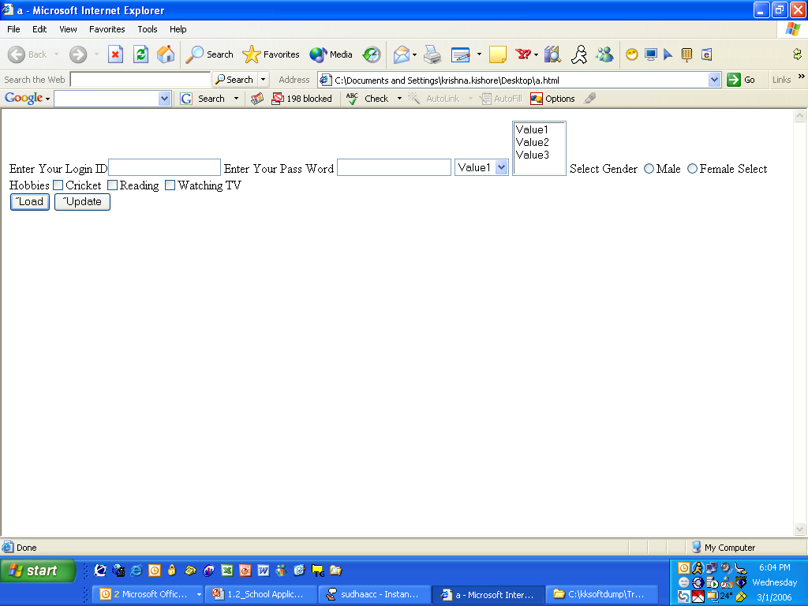
Preview of web page

Slide 16
Cascading StyleSheets (CSS)
The main aim of HTML was to create content for a web page.
HTML tags when used for formatting the web pages, made websites cumbersome and expensive.
Hence, CSS was created by World Wide Web Consortium (W3C) in order to separate out formatting from content creation.
Cascading StyleSheets were introduced from HTML 4.0 where all formatting tags were moved to a separate external .css file.

Slide 17
Cascading StyleSheets (CSS) Syntax
CSS consists of
  Selector
    a HTML element/tag that needs to be defined
  Property
    the attribute that needs a change
  Value
    each property will take a value.
  The property and value are separated by a colon, and surrounded by curly braces
    Syntax: selector {property:value}
    For example: body {color:green} .

Slide 18
Cascading StyleSheets (CSS)
CSS can be used in the following ways:
  Extenal StyleSheet
    can be applied to any number of pages in the website
    will not contain HTML tags
    <link> tag is used to link the Web page to an external style sheet.

Slide 19
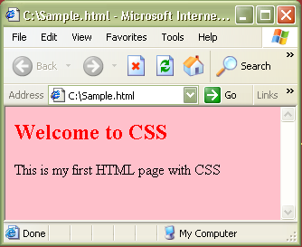
CSS – External StyleSheet Example
<html>
<link rel="stylesheet" type="text/css" href=“my_style.css" />
<h2> Welcome to CSS </h2>
<body> This is my first HTML page with CSS </body>
</html>
Sample.html
Path to the .css file
h2 {color:red}
body {background-color:pink}
my_style.css
Output:

Slide 20
CSS – Internal StyleSheet
  Internal StyleSheet
    can be applied to a particular page that needs a unique format.
    should be included in the head section of HTML page
    <style> tag is used to hold the values for formatting

Slide 21
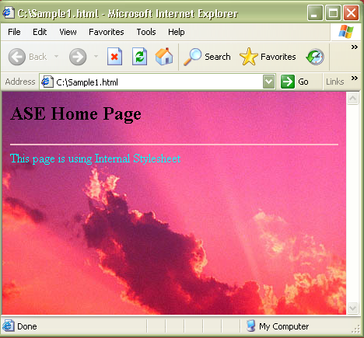
CSS – Internal StyleSheet Example
<html>
<head>
<style type="text/css">
hr{color:pink}
font {color:cyan}
body {background- image:url('c:\Sunset.jpg')}
</style>
<h2> ASE Home Page</h2>
</head>
<hr>
<body>
<font>
This page is using Internal Stylesheet
</font>
</body>
</html>
Output :

Slide 22
CSS – Inline StyleSheet
  Inline StyleSheet
    style attribute is used in the relevant tag.
    style attribute can contain any CSS property.
    For example:
    <html>
    <p style="color:blue">This is a example of inline stylesheet</p>
    </html>

Slide 23
CSS-Pseudo classes
Pseudo classes are used to include special effects to some selectors.
Syntax : selector:pseudo-class {property:value}
For example: a:link {color:#00FF00}
CSS classes can be used with pseudo-classes.
Syntax: selector.class:pseudo-class {property:value}
For example: a.red:visited {color:#FF0000}
<a class="red" href=“c:\css_syntax.html">CSS Syntax</a>

Slide 24
CSS-Pseudo classes
Some of the pseudo classes are
  :active Adds a style to an activated element
  :first-child Adds a style to the first element that is the included in another element
  :focus Adds a style to an element that has keyboard input focus
  :hover Adds a style to an element when mouse moves over it
  :lang Adds a style to an element with the specific lang attribute
  :link Adds a style to an unvisited link
  :visited Adds a style to a visited link

Slide 25
Key points
HTML stands for “Hyper Text Mark up Language” used to create web pages which can run in any browser.
HTML consists of Elements and Tags.
Major elements of HTML are
  Body
  Anchor
  Formatting
  Form is an interface where you can enter text or any information
Cascading StyleSheets are used to formatting the contents of the web page.
CSS- Pseudo classes is used to include special effects to some selectors.

Slide 26
Questions and Comments

